Slide 1



Online Book Store: A Java-Powered Solution
This presentation will explore the design and implementation of an online bookstore application using Java. We'll delve into the key features, architectural choices, and technologies involved in building a robust and user-friendly e-commerce platform for book enthusiasts.

Slide 2


Introduction to the Online Book Store
The online bookstore aims to provide a comprehensive platform for book lovers to browse, discover, and purchase books from a wide variety of genres. It will feature a user-friendly interface, secure payment processing, and efficient inventory management.
1
Accessible Marketplace
2
Seamless Shopping Experience
Offering a wide selection of books from various genres and publishers.
Providing a user-friendly interface for browsing, searching, and purchasing books.
3
Personalized Recommendations
Utilizing user data to suggest books based on individual preferences.

Slide 3


PROJECTS SURVEYED
Online Library management
Inventory management
This project helps manage a library on what books are lent and what books are not.
This helps in managing an inventory and check the availability of products.
Employee Management
This helps in managing employee roles, payrolls, projects etc

Slide 4

Key Features and Functionality
The bookstore will offer a variety of features and functionality to enhance the user experience and streamline operations. These include user accounts, search and filtering options, personalized recommendations, and a shopping cart.
User Accounts
Search and Filtering
Personalized Recommendations
Allow users to create profiles, track orders, and save their preferences.
Enable users to easily find books based on title, author, genre, or other criteria.
Suggest books based on user browsing history, purchase history, or ratings.

Slide 5


Architectural Design and Technology Stack
The online bookstore's architecture is designed to be scalable, secure, and maintainable. It will utilize a layered approach with a Java-based backend, a relational database for data storage, and a responsive front-end.
1
Backend
Java Spring framework for RESTful APIs, handling business logic and database interactions.
2
Database
MySQL for storing book data, user information, and order details.
3
Frontend
HTML, CSS, and JavaScript for creating a visually appealing and interactive user interface.

Slide 6

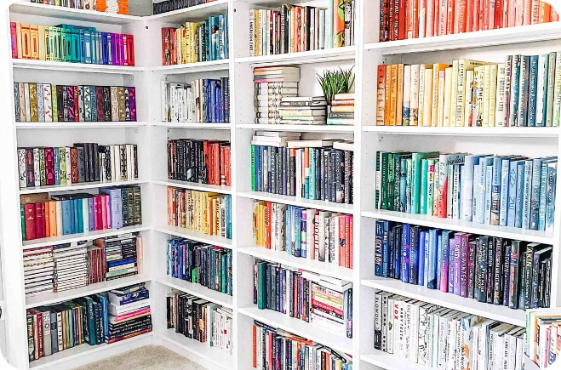
Inventory Management and Order Processing
The online bookstore will implement an efficient inventory management system and order processing workflow. This will ensure accurate tracking of available books, timely order fulfillment, and efficient customer service.
Feature
Description
Inventory Tracking
Monitoring stock levels, managing book availability, and preventing overselling.
Order Management
Processing customer orders, managing shipping and delivery, and providing order tracking.
Customer Support
Responding to customer inquiries, resolving order issues, and providing assistance.

Slide 7


Scalability and Future Enhancements
The online bookstore's architecture will be designed to scale efficiently as the user base and inventory grow. Future enhancements will include personalized recommendations, social media integration, and advanced analytics.
Personalized Recommendations
Leveraging machine learning algorithms to suggest books tailored to individual preferences.
Social Media Integration
Enabling users to share their favorite books and connect with other book lovers.
Advanced Analytics
Collecting data on user behavior and book preferences to improve the platform.

Slide 8


Conclusion and Next Steps
The online bookstore project aims to create a comprehensive and engaging e-commerce platform for book lovers. The development process will involve careful planning, design, and implementation, ensuring a robust and user-friendly application.
Continued Development
Community Engagement
The online bookstore will continue to evolve with new features and enhancements based on user feedback and market trends.
Building a strong community of book lovers by providing opportunities for interaction and book discussions.

